Slide 1
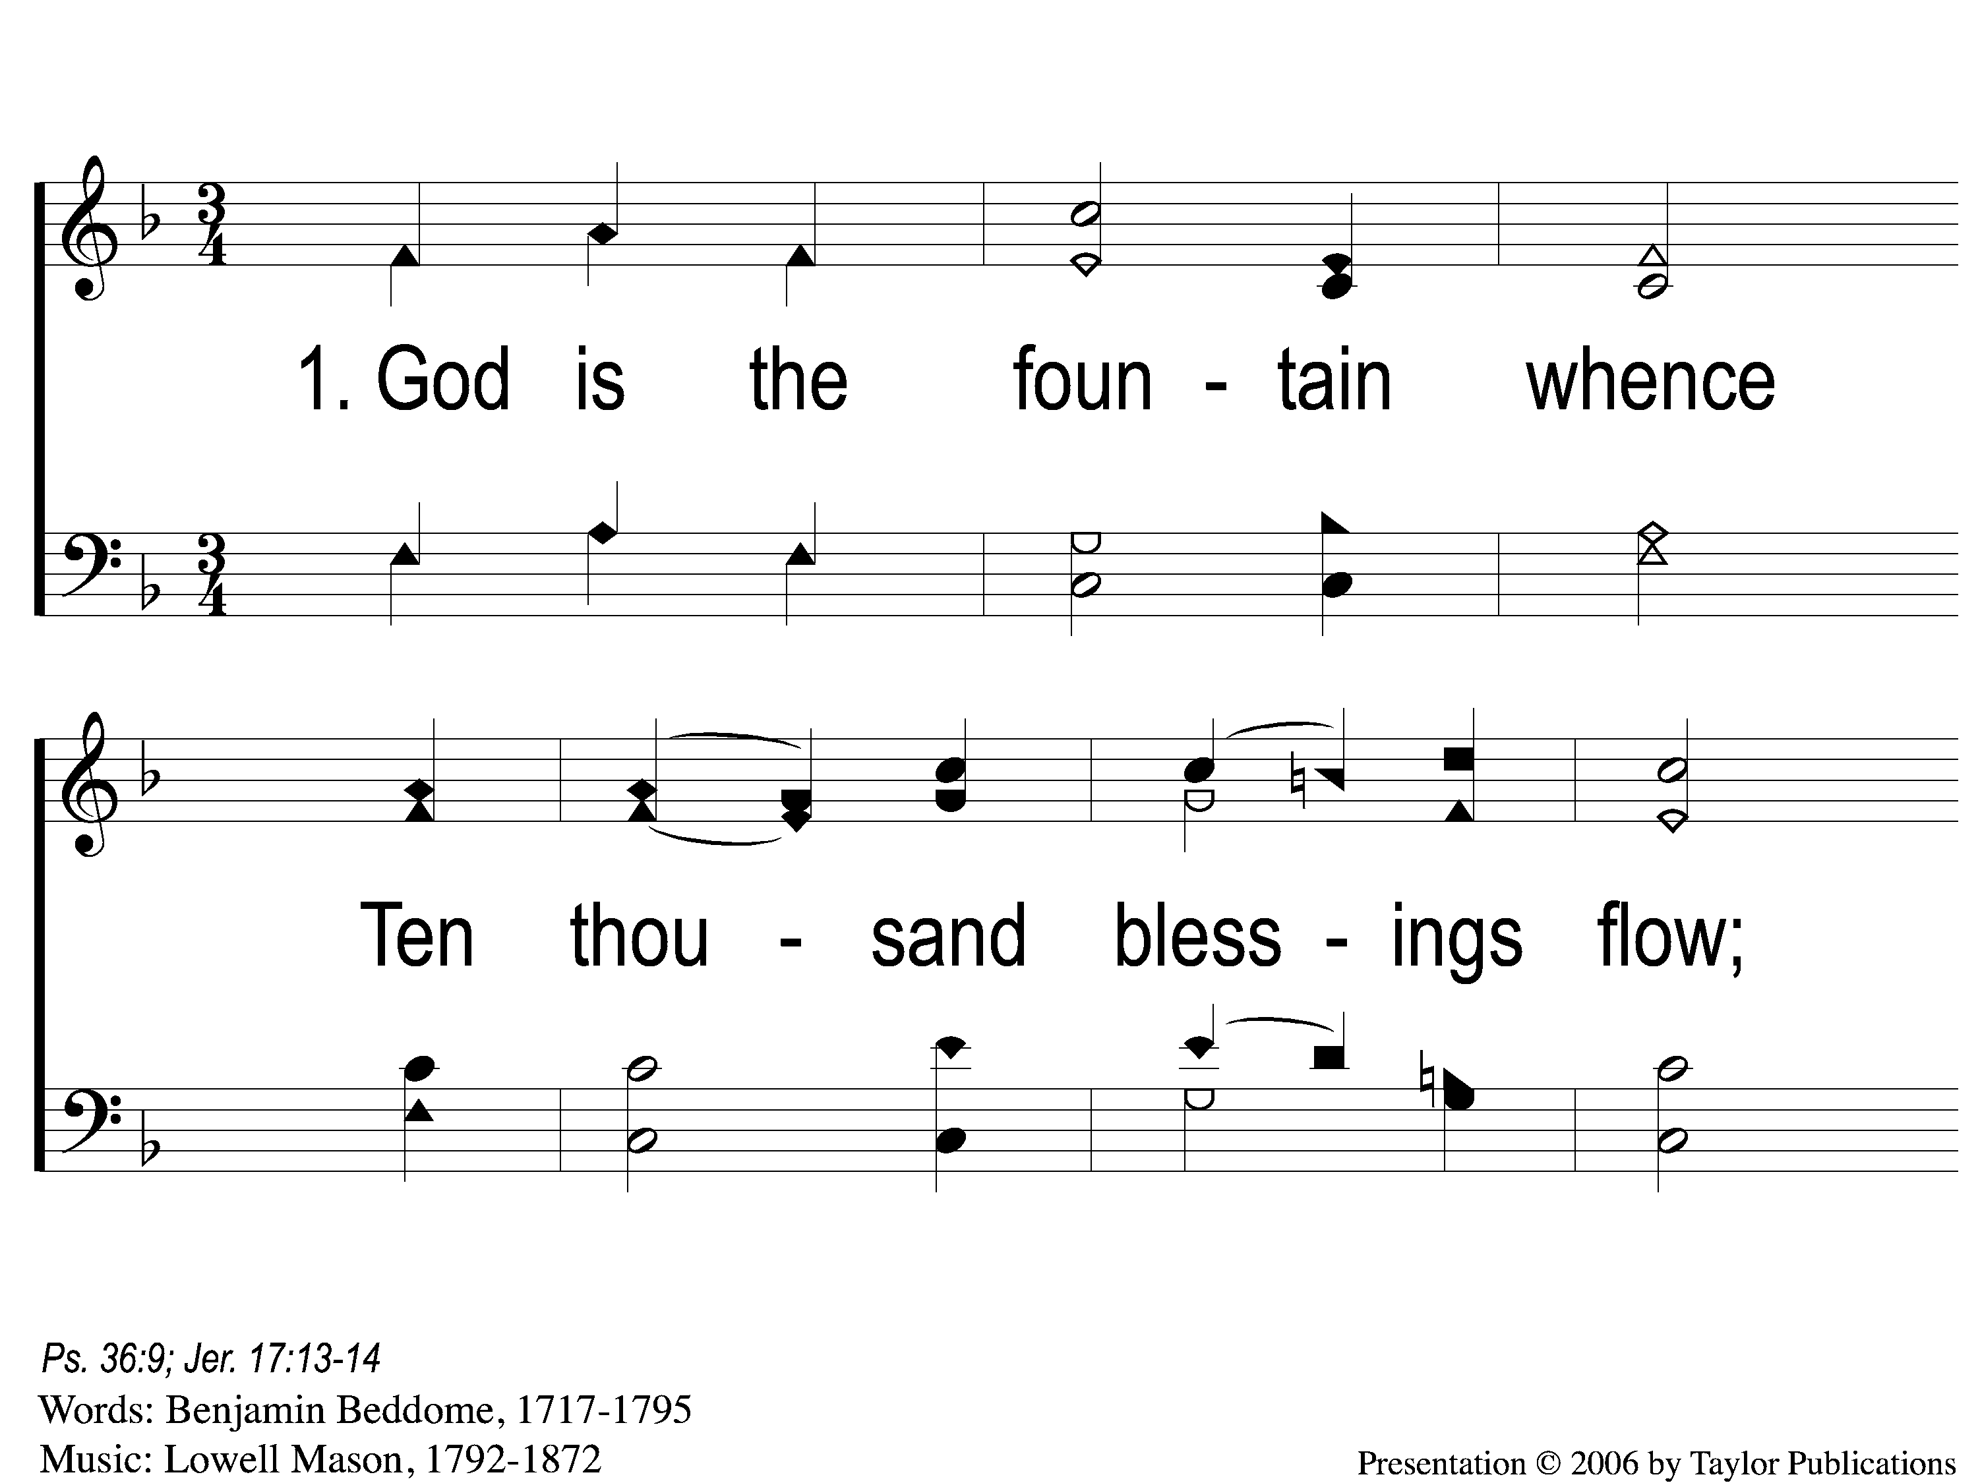
1-1 God is the Fountain Whence
God Is The Fountain Whence
134

Slide 2
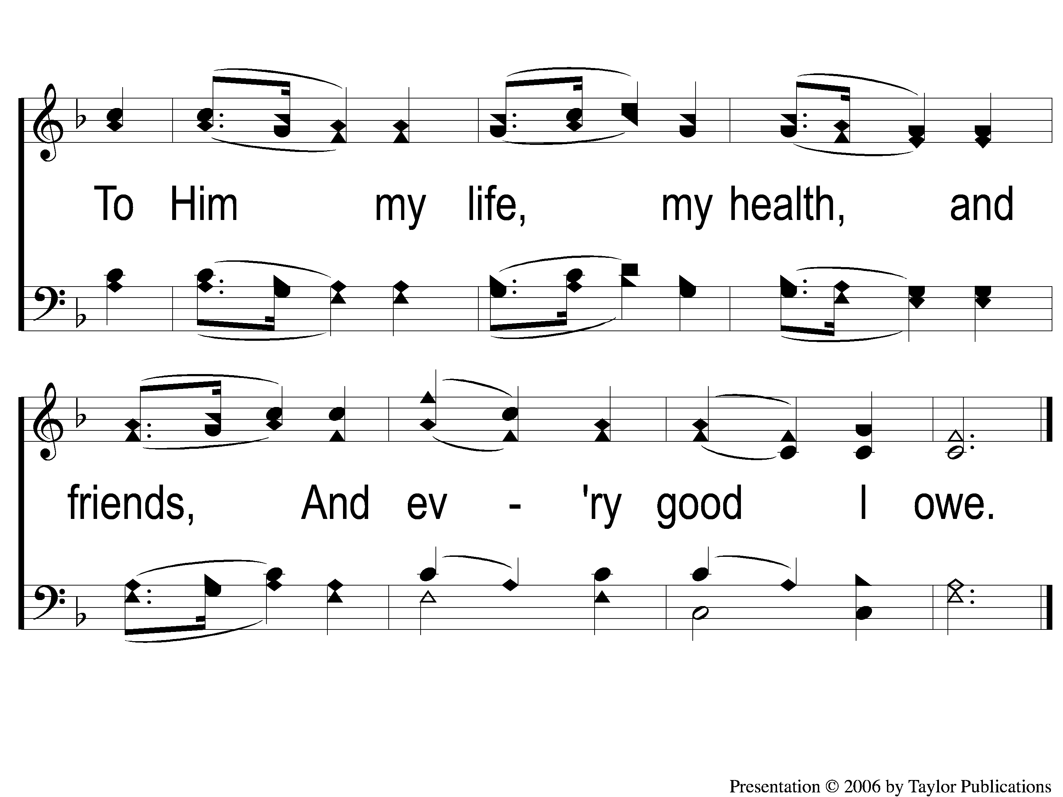
1-2 God is the Fountain Whence
God Is The Fountain Whence
134

Slide 3
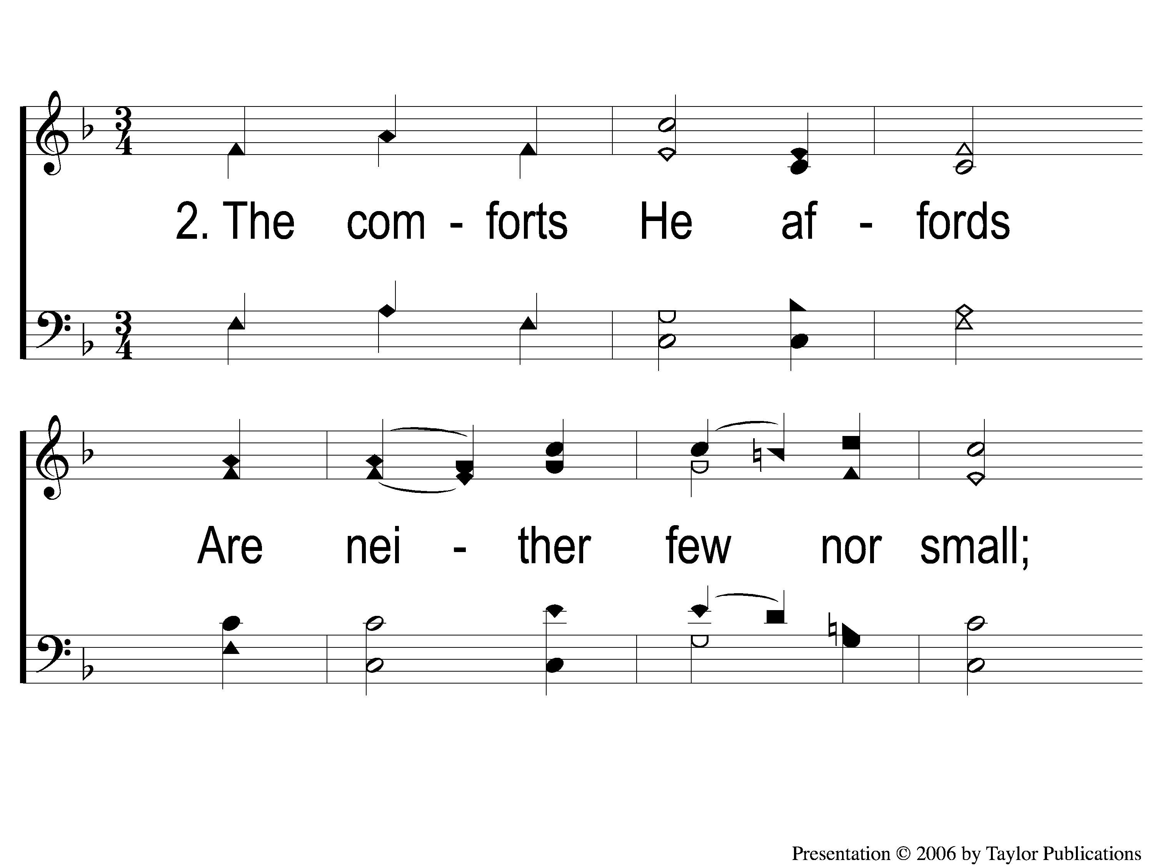
2-1 God is the Fountain Whence
God Is The Fountain Whence
134

Slide 4
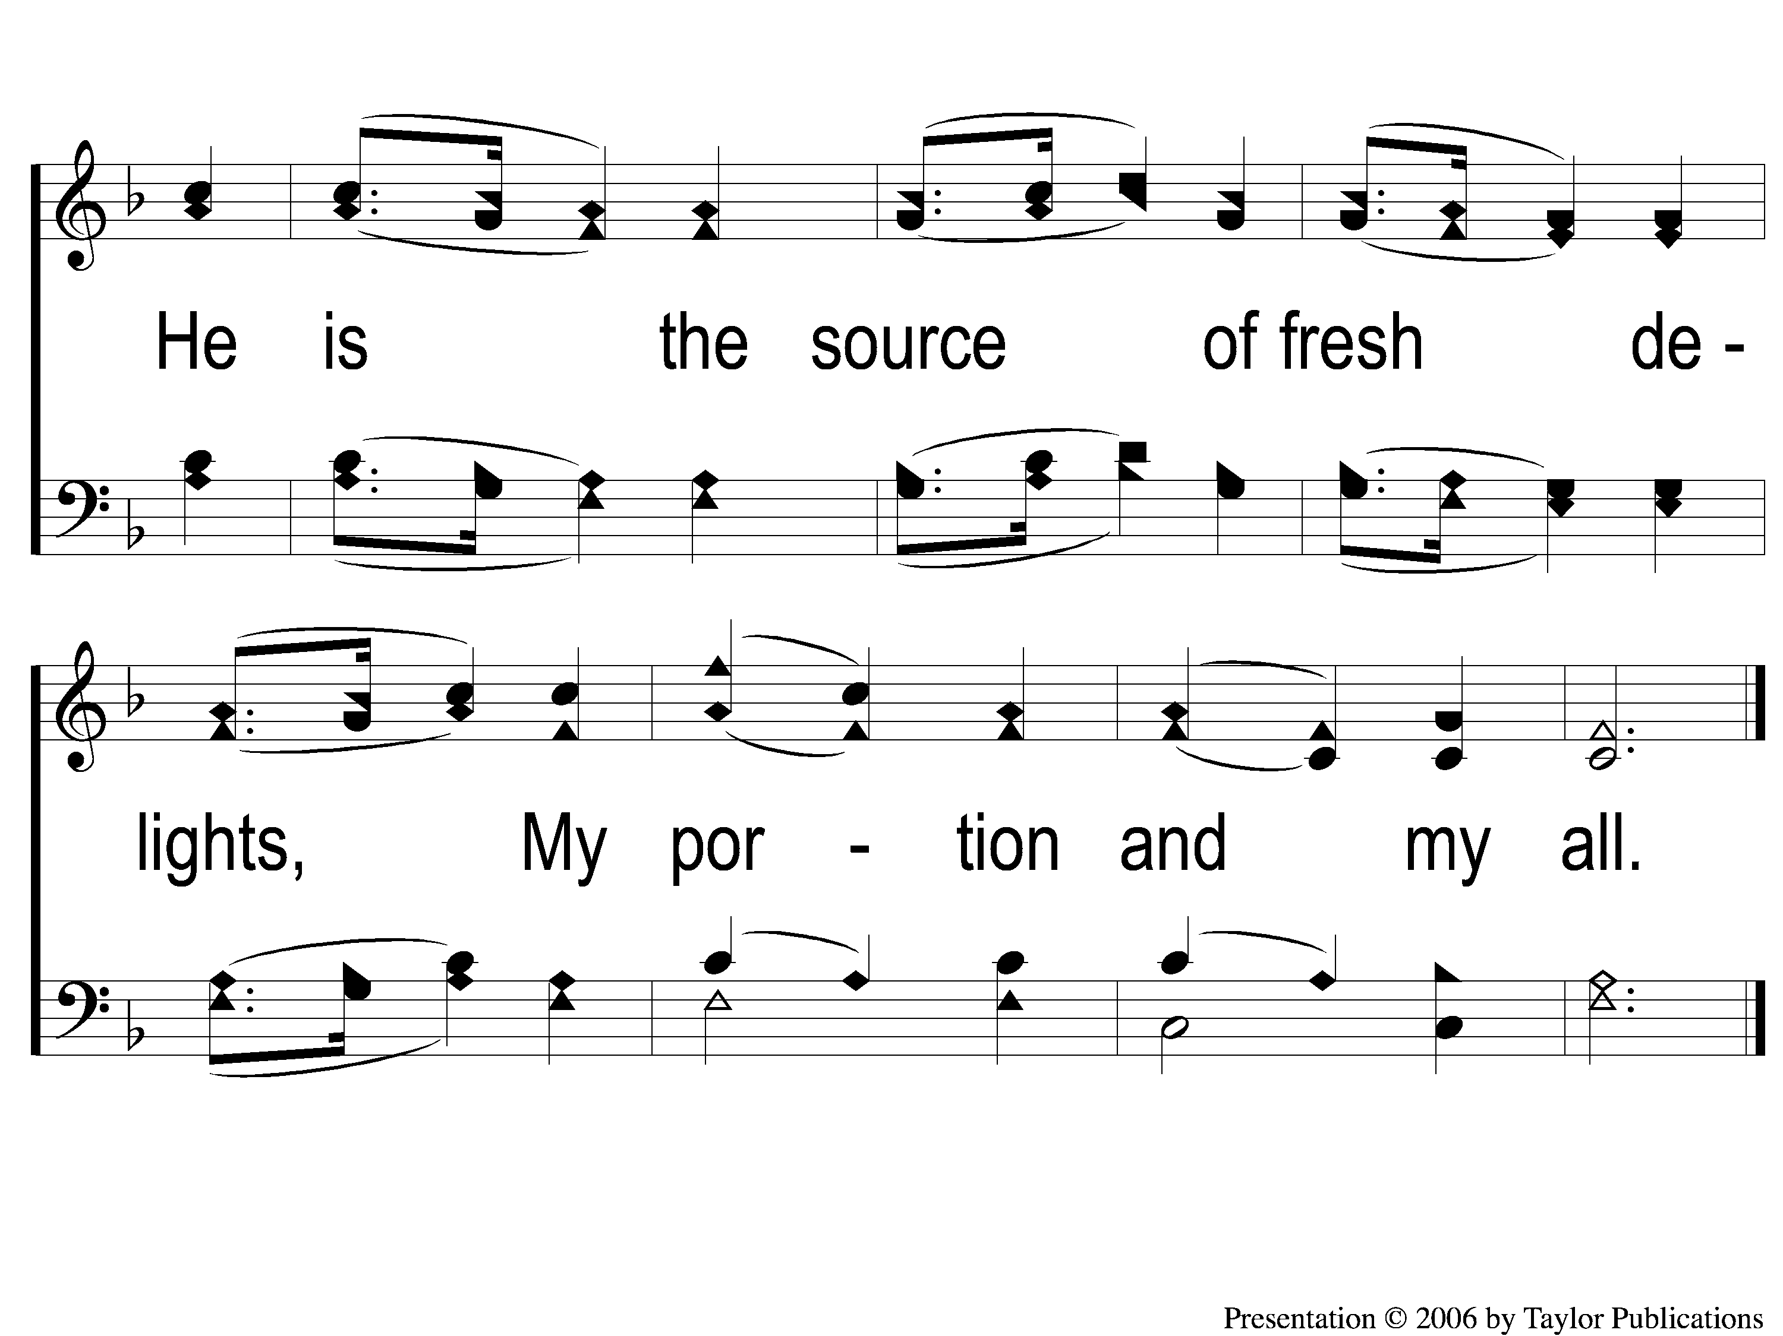
2-2 God is the Fountain Whence
God Is The Fountain Whence
134

Slide 5
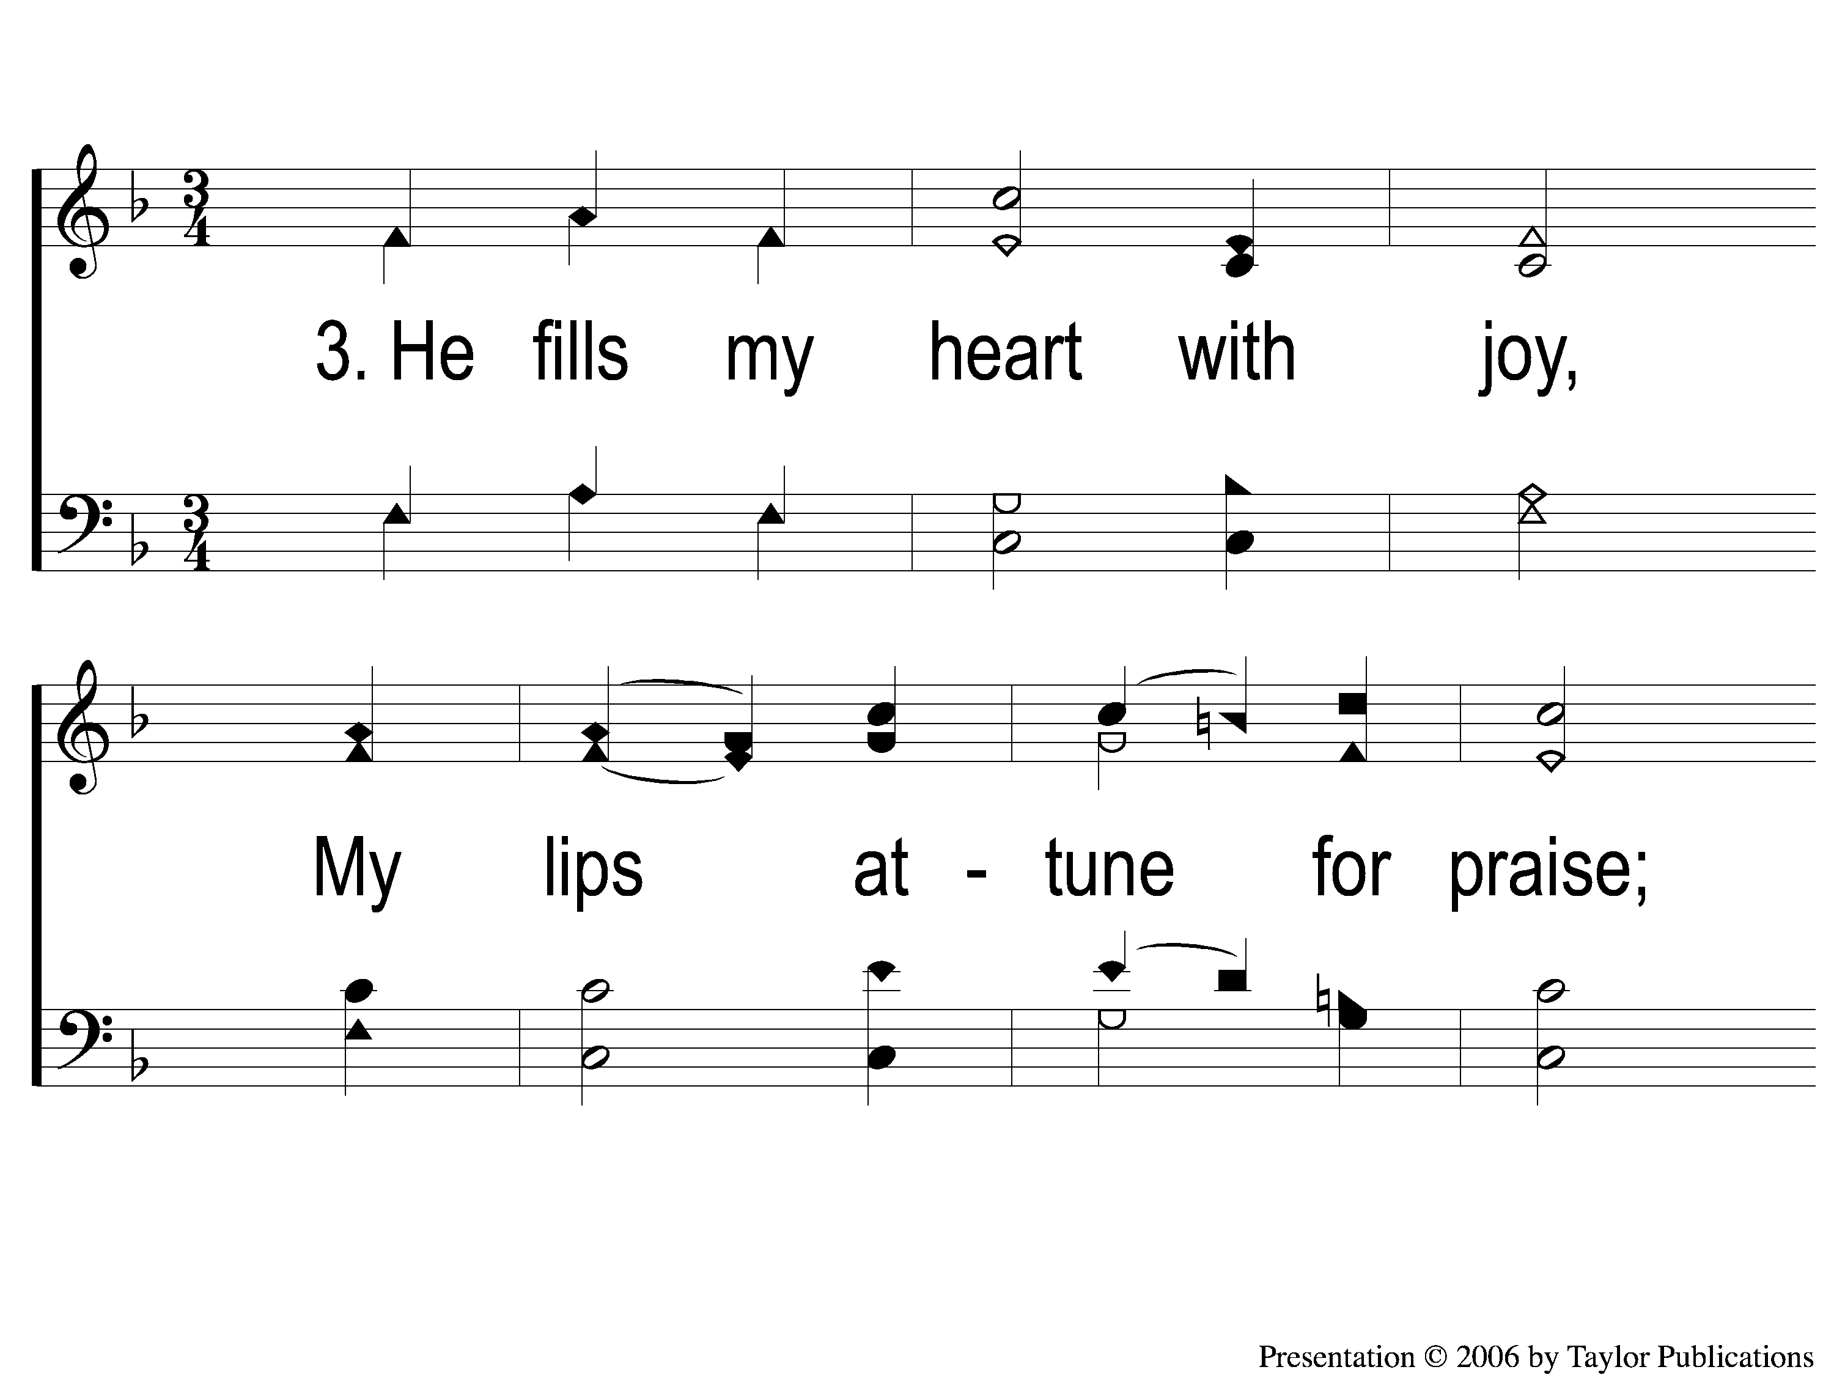
3-1 God is the Fountain Whence
God Is The Fountain Whence
134

Slide 6
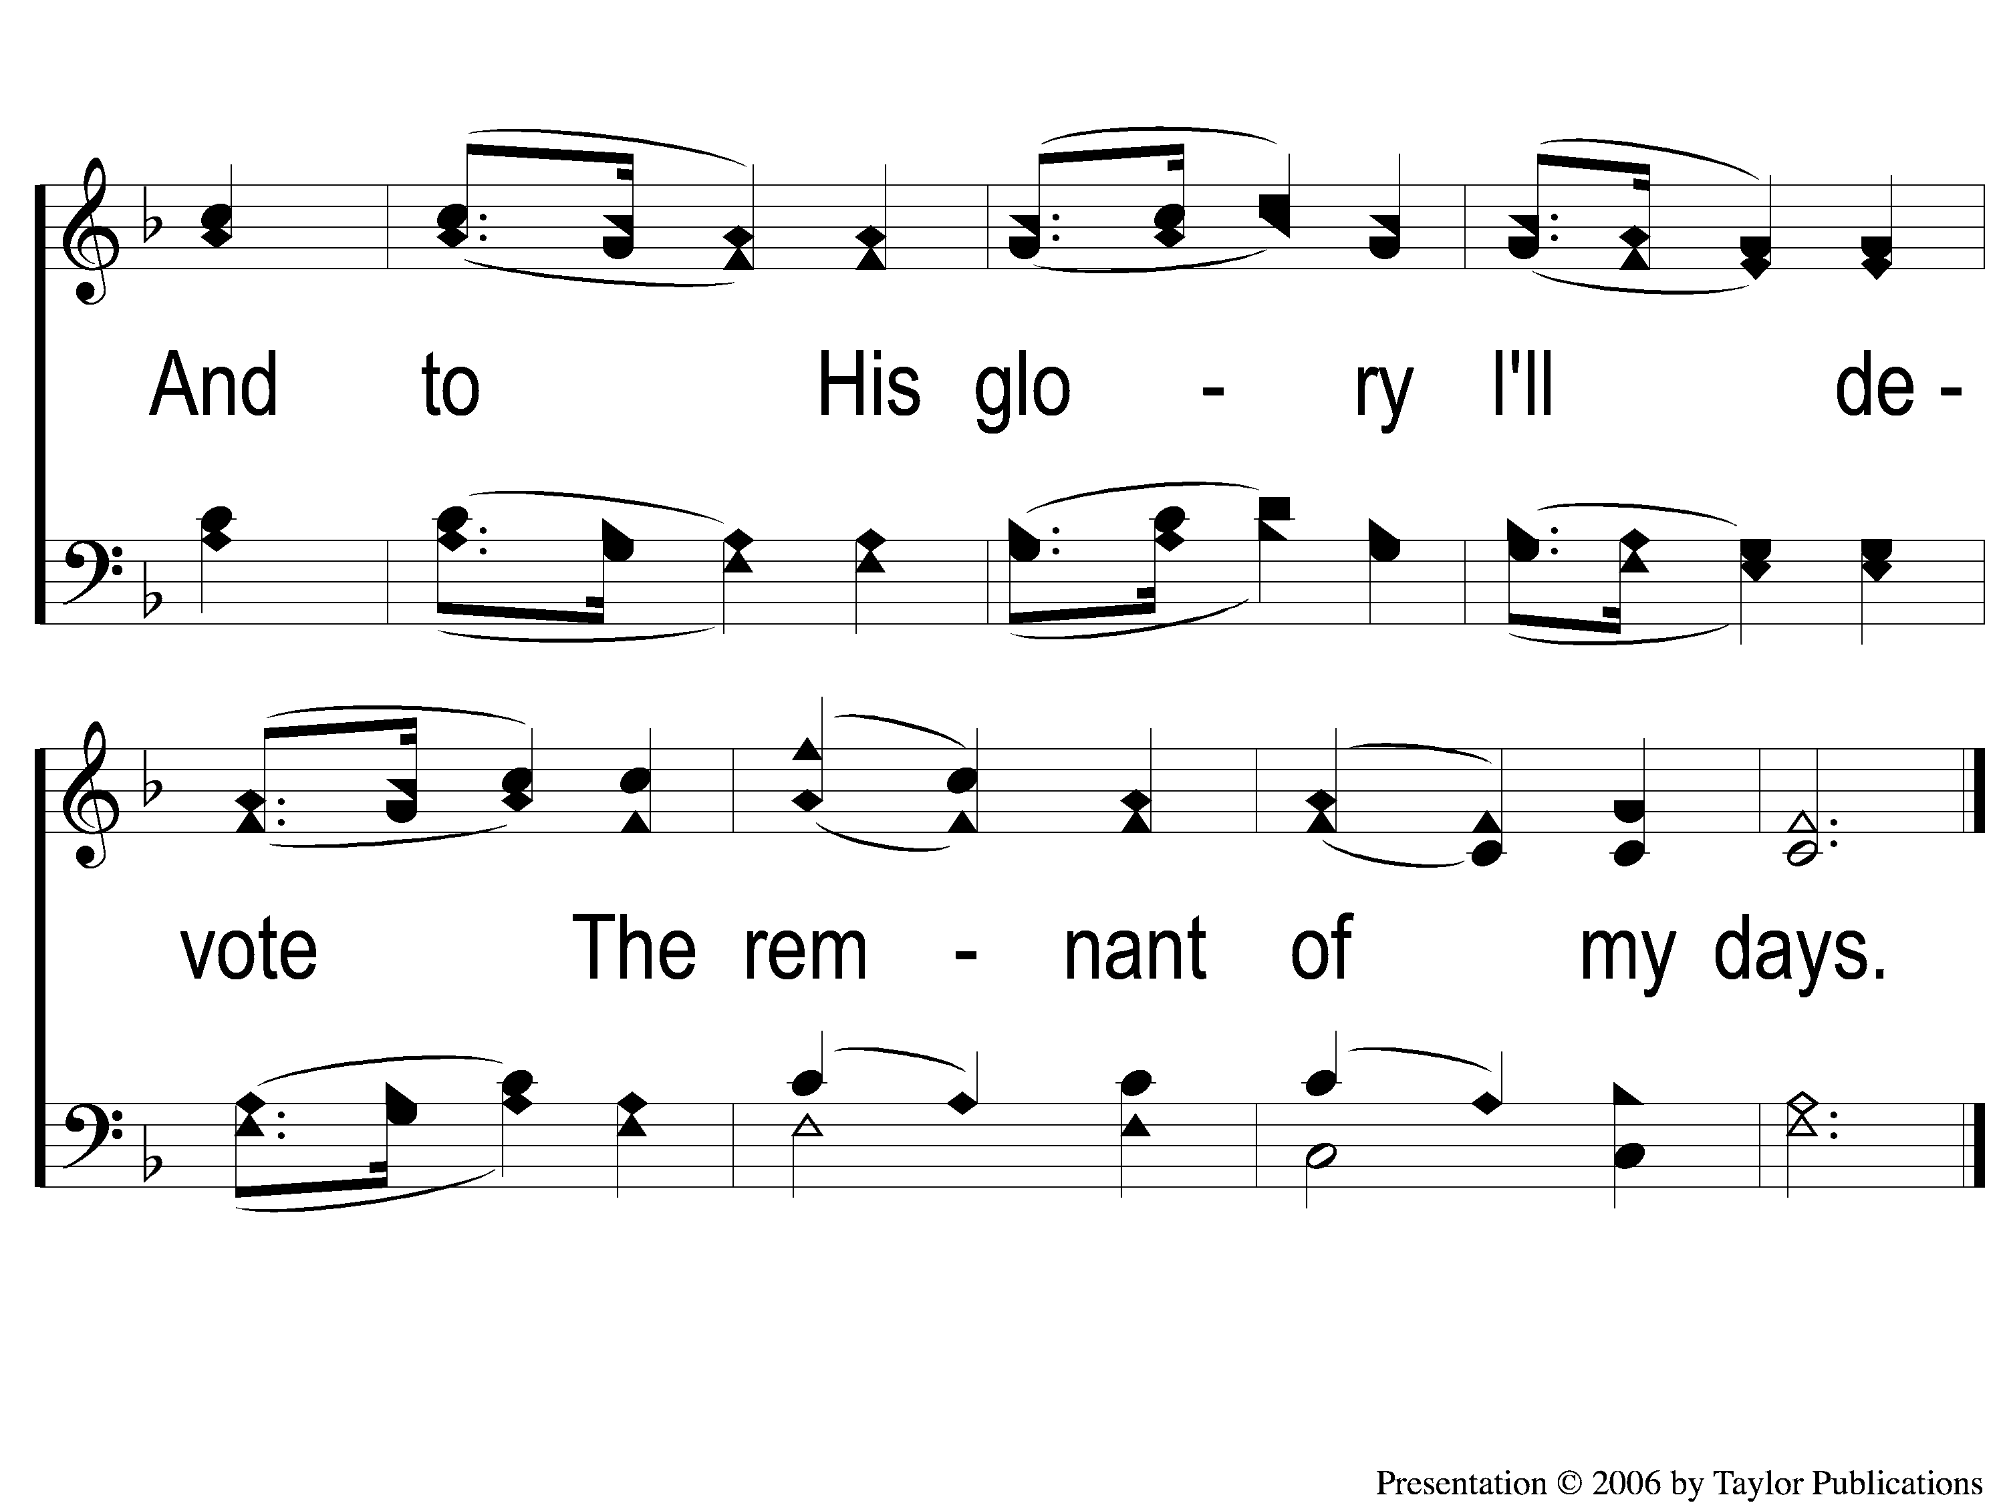
3-2 God is the Fountain Whence
God Is The Fountain Whence
134

